Slide 1
Introduction to Predictive Analytics
Russ Bramblett

Slide 2
Before we begin
Things to do now:
If you don’t have it, download and install Anaconda 3.6: https://www.anaconda.com/download/
Download this presentation and the associated code from git: https://github.com/russbramblett/PredictiveAnalytics

Slide 3
Agenda
Predictive analytics
A couple of things that give prediction a bad name
Some prediction methods:
Time-series forecasting
Conditional probability
Machine learning
Examples
Summary

Slide 4
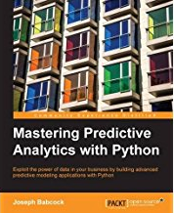
Predictive Analytics
Descriptive analytics tells you the facts (mean, deviation, etc.)
Inferential analytics tell you how one variable affects another variable
Predictive analytics tells you what to expect in the future
Course Content

Slide 5
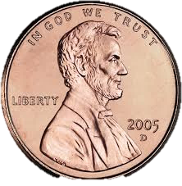

Don’t test a hypothesis with the data that informed your hypothesis
Flip a coin three times:
Based solely on this data, what is your hypothesis about the probability of a coin landing on heads
Testing the hypothesis requires a new and statistically significant dataset

Slide 6
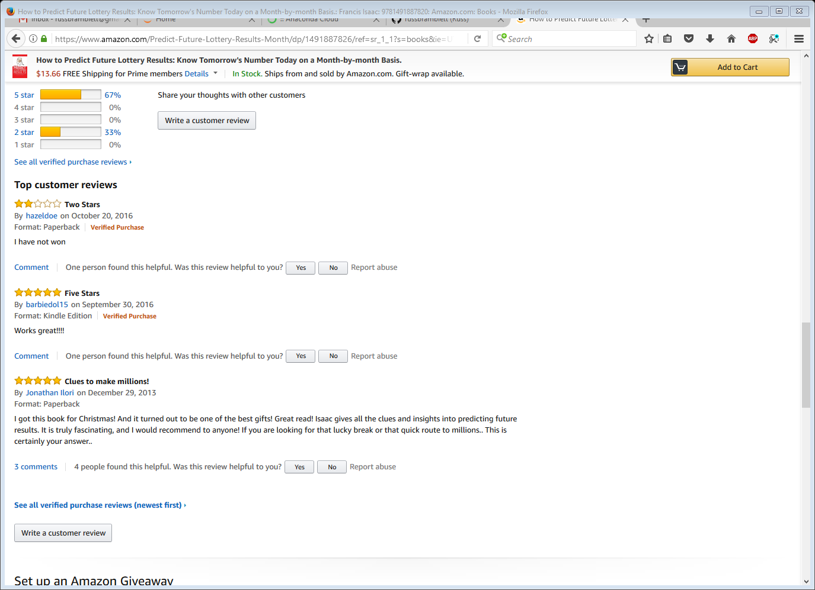
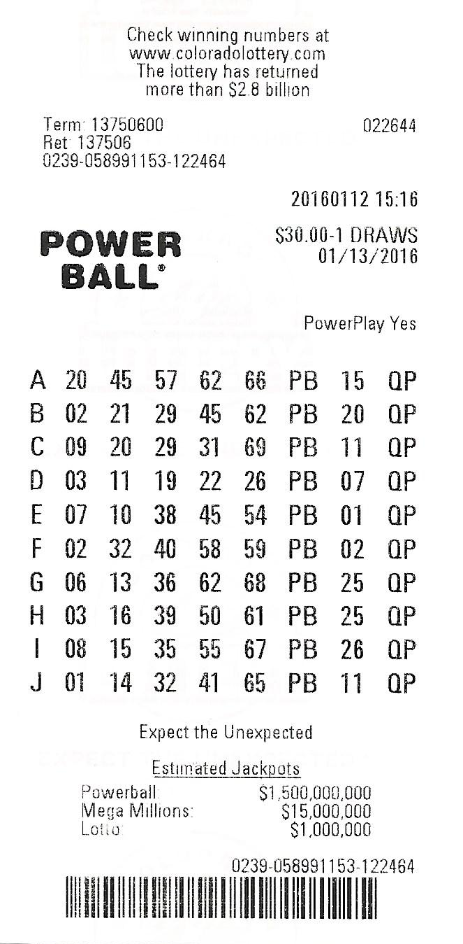
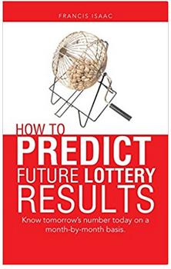
Don’t attempt to predict random events

Slide 7
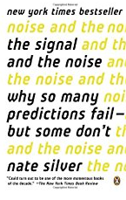
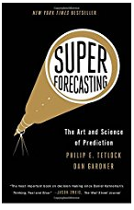
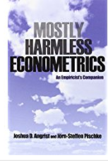
A few good books on the topic
Signal and the Noise
An accessible book that will look great on your shelf
Superforecasting
Combines the metrics and expert opinions to predict outcomes. Was based on a DARPA project
Mostly Harmless Econometrics
Good reference for formulas and their use

Slide 8
Some prediction methods

Slide 9
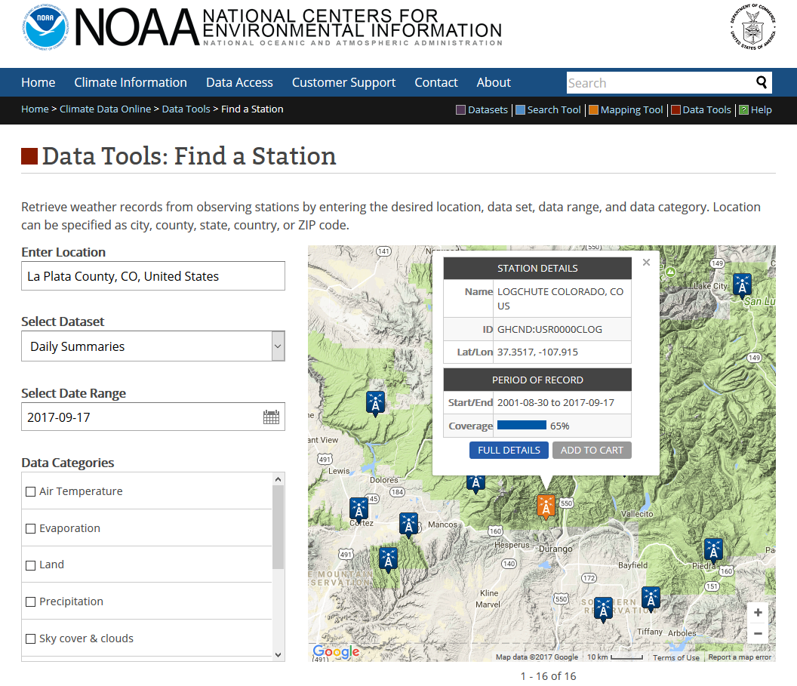
Time Series
Time series forecasting is appropriate when independent variables aren’t known
ARIMA is the best time series estimator as it can handle non-stationarity
Autoregressive
Integrated
Moving Average
Can also be fit to a function

Slide 10
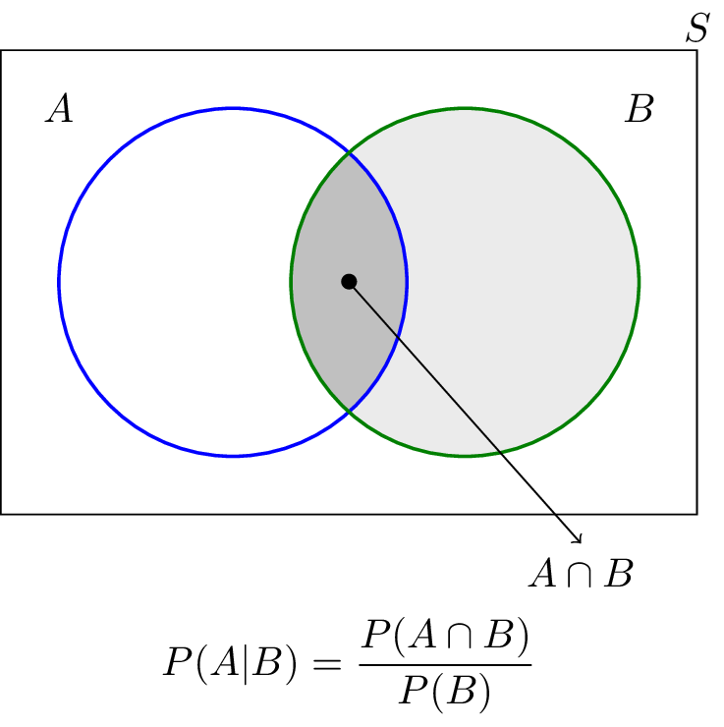
Conditional Probability
“what is the probability of A occurring, given B occurred”?
Intuitive and straightforward math… but easy to calculate incorrectly.
Easy fix: put all numbers into a table
Make Purchase?
 | Yes | No
Male | 150 | 180
Female | 170 | 165

Slide 11
Machine Learning
Manually assigned
D | I1 | I2
Yes | 5 | 5
Yes | 7 | 7
No | 5 | 7
 | 6 | 5
Supervised
Program the computer with what the results should look like
Semi-supervised
Program the computer with what some of the results should look like
Unsupervised (Ahhh!)
It’s ok, this is mainly just a clustering routine (K-mean)
Predicted
Supervised
Semi-supervised
Prior Predicted
D | I1 | I2
Yes | 5 | 5
Yes | 7 | 7
No | 5 | 7
 | 6 | 5
Manually assigned
Predicted

Slide 12
Example (in Jupyter Notebook)

Slide 13
Summary
Lots of good ways to use data to make prediction
Be careful of the pitfalls in prediction

